Slide 1
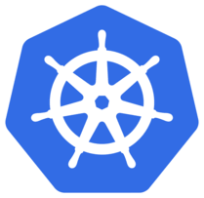

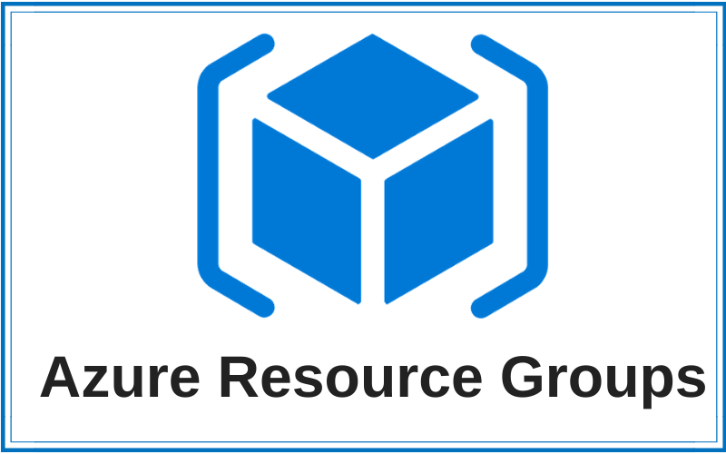

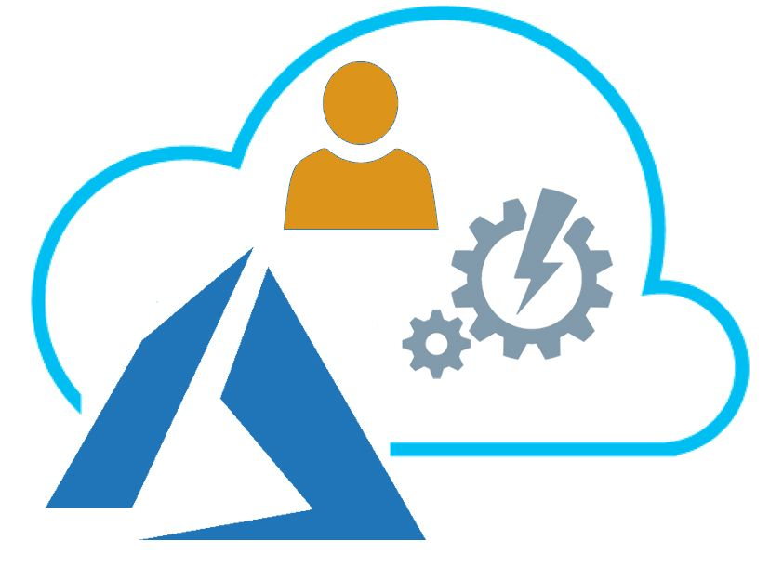
Internet
AKS Public Endpoint
ingress
egress
Azure Managed
Control Plane
Azure Load Balancer
(public)
Vnet
AKS-Public
ingress (zones 1, 2, 3)
Control Plane
BYO Managed Identity
AKS-Private
Vnet
nodepool1 (zone 1)
nodepool2 (zone 2)
nodepool3 (zone 3)
UDR Route Table
Subnets
Route Table
Network Contributor
(AKS Service)
system1 (zone 1)
system2 (zone 2)
system3 (zone 3)
AKS Resources (managed)
Azure Load Balancer
(private) ingress-core-internal
Public IPs
VM Scale Sets
Contributor
Load Balancers
VPN
…

